Slide 1
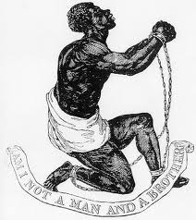
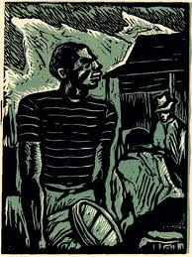
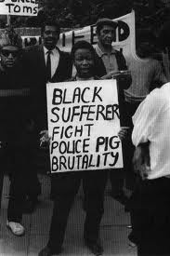

Lecture #5: DEBATE
The radical Black canonical tradition = three great Black debates
1830’s
1930’s
1960’s
Three great debates:
Emancipation
Self-Determination
Black Liberation
Three main solutions:
Escape
Persuade
Fight

Slide 2

Lecture 1: IDEOLOGY
The ideological framework
Identity
Analysis
Commitment
Program
Action

Slide 3
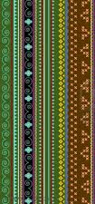
Lecture 2: Methodology
The D-7 Method
D1: Definition
D2: Data
D3: Digitization
D4: Discovery
D5: Design
D6: Dissemination
D7: Difference

Slide 4

Lecture 3: History
Dialectics
Production forces
Production relations
Modes of society
Social cohesion
Social disruption

Slide 5
Modes of
Social cohesion
Africa
Slavery
Rural
Urban
Information
Modes of
Social disruption
Slave trade
Emancipation
Great migrations
Crisis
The basic difference is trans-generation continuity

Slide 6
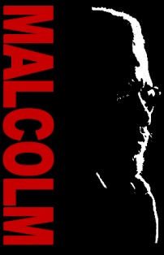
Lecture 4: Radical Black Tradition
Panafricanism
Nationalism
Black Liberation
Feminism
Socialism

Slide 7

Tradition in everyday life has been torn apart by historical
disruptions but never destroyed. Black people survive
through their appropriation of the past and their constant
creative improvisation. We live because we can make music
in every aspect of our lives – always new/old music.
Tradition in ideological frameworks survive through the
protection of dogma as a reference to combat the ever
present problems that reproduce past oppression. The
elders and the books keep us going.

Slide 8
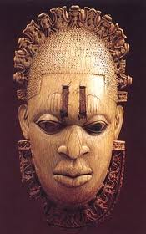
Outline of Lecture #5:
What is debate?
What is a great African American debate?
3. What can we learn from the Emancipation Debate?
4. What can we learn from the Self-Determination Debate?
What can we learn from the Black Liberation Debate?
6. What is the next Great Debate?
7. Why this lecture series?

Slide 9
What is the canon of Black thought?
A canon is usually a set of essential readings, what must be read to understand the subject. Black literary scholars have argued that the canon of literature can’t be limited to the West, and ignore the literature of the global south (Asia, Africa, and Latin America), and the canon of American Literature certainly cant exclude Black writers. But we ask a different question. What is the canon of Black thought? What are the essential texts that define the tradition of ideological frameworks? What does everyone need to know? No single text will do.
We want to point past dogma to debate.

Slide 10


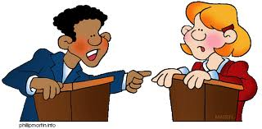
What is debate? Disagreements over different positions on an issue whereby two or more parties exchange views and attempt to refute each other and convince a population of people to accept their position.
Community debates can be formal or informal, face to face or over a long period of time, but they must be inter-textual and take up arguments of opposing points of view. There are formal votes if the debate takes place in a organization or on an editorial board, but in general the outcome of community or movement debates is determined by what people do as a result of how deeply they debate.

Slide 11


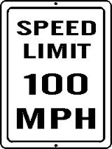
The Debate: Three Roads to Freedom
Should we appeal to persuade?
arguments of reason, morality,
history, and law to change minds
2. Should we migrate to escape?
leaving one location for another in
search of a better life
3. Should we use power to fight?
using economic, political or
physical force to change society
We have debated these options for over 200 years!

Slide 12
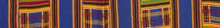
What is a “great debate”?
A debate that dominates the discourse among leading intellectuals, and all printed and spoken forums of the day, and by the masses of people. A “great debate” takes place everywhere people gather.
It takes place as a specialized discussion but also as forums that reflect public opinion, so major conferences are important.
It is a reflection of fundamental objective conditions of change, especially modes of social disruption, transformation.
It creates literature – texts – that stand as markers of a historical period and define a paradigmatic framework for a historical period.
5. It maintains inter-textuality with previous “great debates.”

Slide 13
Modes of
Social cohesion
Africa
Slavery
Rural
Urban
Information
Modes of
Social disruption
Slave trade
Emancipation
Great migrations
Crisis
Great Debate #1
Great Debate #2
Great Debate #3

Slide 14
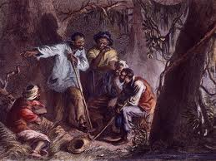
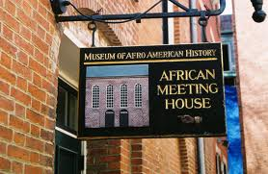
Emancipation Debate:
How can Black people get free?
The Abolitionist Movement, The Civil War, The Reconstruction

Slide 15
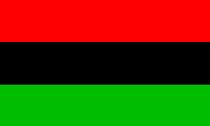

Context: Origin of the organized Black community
Four events took place in 1787: first, in Philadelphia
Richard Allen and Absolom Jones founded the first
independent Black church. They also formed the
Free African Society as a mutual Black benefit society.
In New York the white New York Manumission
Society set up the first formal school for Blacks, the
African Free School. In Boston this same year the
charter arrived from England to set up the first lodge
for Black Masons based on the leadership of Prince
Hall, a Black man free for 22 years. This was 224
years ago. The US founding constitutional
convention was held in that year.

Slide 16
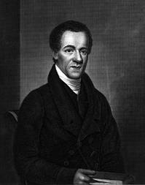
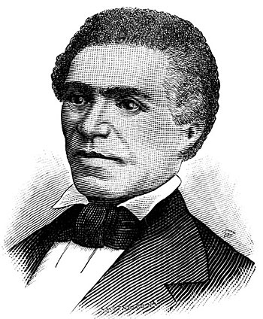
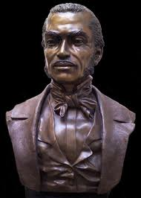
More Black Agency
Sam Cornish
1795 - 1858
John Russwurm
1799 - 1851
Frank McWorter
1777 - 1854
Another leap began in 1827 when Samuel Cornish and John B. Russwurm founded The Freedom’s journal, the first Black newspaper. Then in 1830 the National Negro Convention Movement began. That year Frank McWorter moved to Pike County (IL), and then was the first Black man to found a town in the US (1836). All of this was happening while the majority of Black people were captive slaves. Black people were their own emancipators.

Slide 17
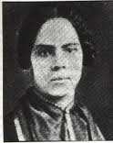
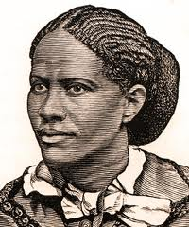
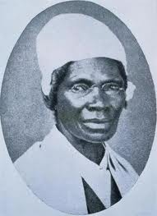
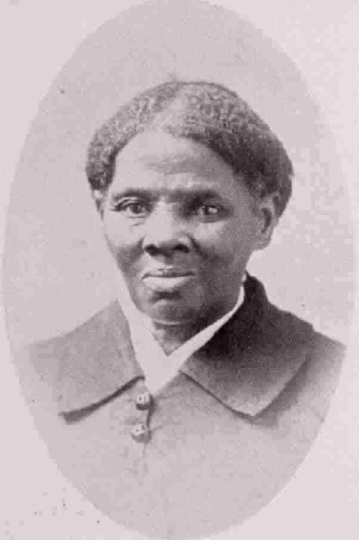
Black women are leaders in the debate!
Maria Stewart
(1803-1879)
Frances Ellen Watkins Harper
(1825-1911)
Sojourner Truth
1797 - 1883
Harriet Tubman
(1822 – 1913)
 | There is a great stir about colored men getting their rights, but not a word about the colored women; and if colored men get their rights, and not colored women theirs, you see the colored men will be masters over the women, and it will be just as bad as it was before. So I am for keeping the thing going while things are stirring; because if we wait till it is still, it will take a great while to get it going again...I want women to have their rights. In the courts women have no right, no voice; nobody speaks for them. I wish woman to have her voice there... —Sojourner Truth

Slide 18
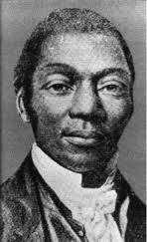
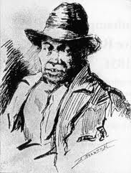
The drums of revolt began to beat!
David Walker’s Appeal (1830):
“The whites have always been an unjust, jealous, unmerciful, avaricious and blood-thirsty set of beings, always seeking after power and authority.”
Nat Turner’s Confession (1831):
“Knowing the influence I had obtained over the minds of my fellow-servants (not by the means of conjuring and such like tricks—for to them I always spoke of such things with contempt)…I should arise and prepare myself, and slay my enemies with their own weapons.”

Slide 19
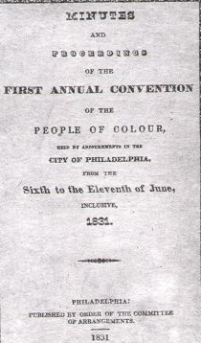
National Negro Convention Movement
(1830 – 1865)
1830’s: General discussions often dominated by white abolitionists
1840’s: Blacks took charge and the Moral Persuasionist position dominated
over the political struggle position
1850’s: After the Fugitive Slave Act was passed in 1850 positions became
more militant with the Emigrationist
position competing with the position
to Fight Back

Slide 20
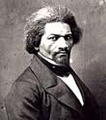
National Negro Convention Movement (1830 – 1865)
“the best means of abolishing slavery is the proclamation of the truth, and the best means of destroying caste is the mental, moral and industrial improvement of our people….Liberty is always sufficient to grapple with tyranny. Free speech-free discussion-peaceful agitation-the foolishness of preaching-these, under God, will subvert this giant crime, and send it reeling to its grave, as if smitten by a voice from the throne of God.”
Frederick Douglass
1818 - 1885
Moral Persuasion

Slide 21
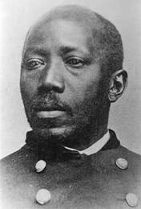
National Negro Convention Movement (1830 – 1865)
“Our attention must be turned in direction towards those places where the black and colored man comprise, by population, and constitute by necessity of numbers, the ruling element of the body politic; and where, when occasion shall require it, the issue can be made and maintained on this basis; where our political enclosure and national edifice can be reared, established, walled, and proudly defended on this great elementary principle of original identity. Upon this solid foundation rests the fabric of every substantial political structure in the world”
Martin Delaney
1812 - 1885
Emigration

Slide 22
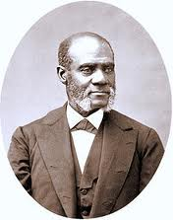
National Negro Convention Movement (1830 – 1865)
If they then commence the work of death, they and not you, will be responsible for the consequences. You had better all die, die immediately, than live slaves, and entail your wretchedness upon your posterity.... However much you and all of us may desire it there is not much hope of Redemption without the shedding of blood. If you must bleed, let it all come at once-rather die freemen than live to be slaves.” 1843
Henry Highland Garnet
1815 - 1888
Armed Struggle

Slide 23
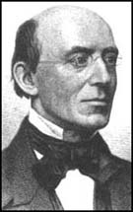
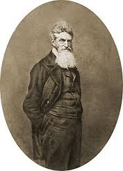
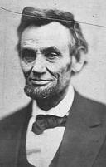
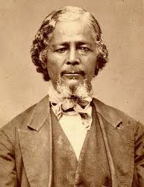
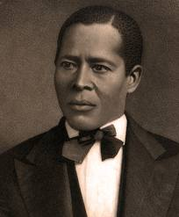
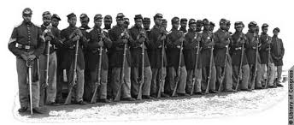

The outcomes of the debate
Persuasion:
William Lloyd Garrison
President Lincoln,
Black Reconstruction
Emigration:
Underground Railroad
Canada
Liberia
Benjamin “Pap” Singleton
Fight:
slave revolts
John Brown
Civil War

Slide 24
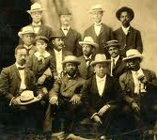
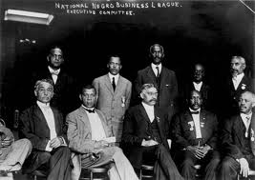
Self-Determination Debate
How should Black people organize their “freedom”?
Niagara Movement
National Negro Business League
Segregation, Migration, Integration

Slide 25
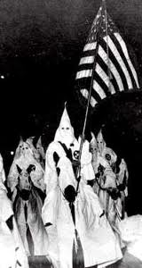
Context: Origin of 2nd class citizenship = “freedom?”
Freedom meant becoming 2nd Class
citizens. Constitutional
Amendments were ratified, 13th
(1865), 14th (1868) and 15th (1870)
but the Reconstruction ended with
a betrayal in 1877. The KKK was
formed in 1865 and the Supreme
Court sanctioned segregation in their
Plessy v. Ferguson “separate but
equal” ruling in 1896. Europe held
their Berlin Conference to carve up
Africa in 1884-85. Workers
capitulated and to reformism in the
2nd International (1889-1916).

Slide 26
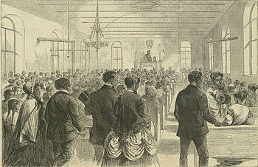
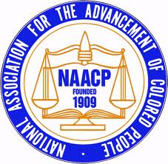
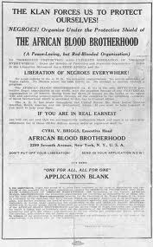


Context: Black Agency
Black Towns: From 1865 to 1920
over 50 Black towns were created
Labor: NCLU formed in 1869
Black Schools: By 1870 the Freedmans Bureau has set
up over 1,000 schools for Black people. From 1866 to 1
872 the American Missionary
Association set up 25 colleges
including Fisk, Dillard and Shaw.
Organizations:
1896 NACWC
1909 NAACP
1910 Urban League
1914 UNIA
1920 African Blood Brotherhood

Slide 27
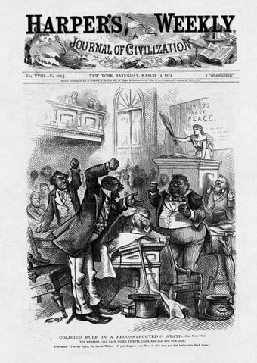
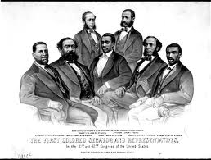
During Reconstruction Black agency
went all the way to the US Congress!

Slide 28
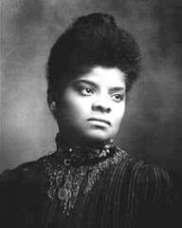
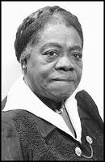
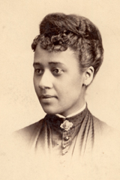
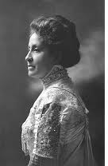
Self-Determination Means Women Led
Ida B Wells
1862 - 1931
Mary McLeod Bethune
1875 - 1955
Anna J Cooper
1858 - 1964
Mary Church Terrell
1863 - 1954
Through the National Association of Colored Women, which was formed by the union of two large organizations in July, 1896, and which is now the only national body among colored women, much good has been done in the past, and more will be accomplished in the future, we hope. Believing that it is only through the home that a people can become really good and truly great, the National Association of Colored Women has entered that sacred domain. Homes, more homes, better homes, purer homes is the text upon which our have been and will be preached.—Mary Church Terrell

Slide 29
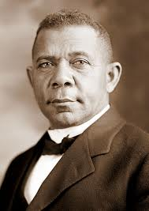

“The wisest among my race understand that the agitation of questions of social equality is the extremist folly, and that progress in the enjoyment of all the privileges that will come to us must be the result of severe and constant struggle rather than of artificial forcing. No race that has anything to contribute to the markets of the world is long in any degree ostracized. It is important and right that all privileges of the law be ours, but it is vastly more important that we be prepared for the exercise of these privileges. The opportunity to earn a dollar in a factory just now is worth infinitely more than the opportunity to spend a dollar in an opera-house.”
Booker T. Washington
1856 - 1915
Accomodationism

Slide 30
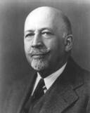
“Our deepest fear is not that we are inadequate. Our deepest fear is that we are powerful beyond measure. It is our light, not our darkness, that frightens us most. We ask ourselves, ‘Who am I to be brilliant, gorgeous, talented, and famous?’ Actually, who are you not to be? You are a child of God. Your playing small does not serve the world. There is nothing enlightened about shrinking so that people won't feel insecure around you. We were born to make manifest the glory of God that is within us. It's not just in some of us; it's in all of us. And when we let our own light shine, we unconsciously give other people permission to do the same. As we are liberated from our own fear, our presence automatically liberates others.”
W.E.B. DuBois
1868 - 1963
Transformation

Slide 31
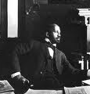
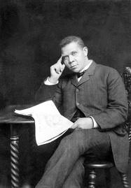
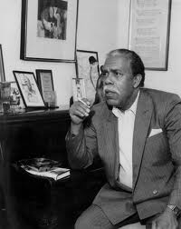
"It seems to me," said Booker T., "That all you folks have missed the boat Who shout about the right to vote, And spend vain days and sleepless nights In uproar over civil rights. Just keep your mouths shut, do not grouse, But work, and save, and buy a house." "I don't agree," said W.E.B. "For what can property avail If dignity and justice fail? Unless you help to make the laws, They'll steal your house with trumped-up clause. A rope's as tight, a fire as hot, No matter how much cash you've got. Speak soft, and try your little plan, But as for me, I'll be a man." "It seems to me," said Booker T.-- "I don't agree," Said W.E.B.
Booker T. and W.E.B.
Booker T. Washington and W.E.B. DuBois
By Dudley Randall "It seems to me," said Booker T., "It shows a mighty lot of cheek To study chemistry and Greek When Mister Charlie needs a hand To hoe the cotton on his land, And when Miss Ann looks for a cook, Why stick your nose inside a book?" "I don't agree," said W.E.B. "If I should have the drive to seek Knowledge of chemistry or Greek, I'll do it. Charles and Miss can look Another place for hand or cook, Some men rejoice in skill of hand, And some in cultivating land, But there are others who maintain The right to cultivate the brain."
Dudley Randall
1914-2000

Slide 32
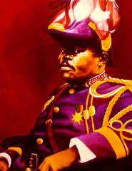
A people without the knowledge of their past history, origin and culture is like a tree without roots.
Africa for the Africans... at home and abroad!
I have no desire to take all black
people back to Africa; there are
blacks who are no good here and
will likewise be no good there.
God and Nature first made us what we are, and then out of our own created genius we make ourselves what we want to be.
Marcus Garvey
1887 - 1940
Back to Africa

Slide 33
20th century drama of dogma and debate
 | Marcus Garvey | W.E.B. DuBois | Booker T Washington
Organization | UNIA | Atlanta University Niagara Movement NAACP | Tuskegee Institute NNBL
Conferences | International conventions | Atlanta Univ. Conferences Pan African Congresses | Tuskegee annual NNBL annual
Periodicals | The Negro World | Phylon Crisis | The New York Age
Books | Philosophy and Opinions | Three Autobiographies | Up From Slavery
“...Garvey is a sincere, hard-working idealist; he is also a stubborn, domineering leader of the mass; he has worthy industrial and commercial schemes but is an inexperienced businessman. His dreams of Negro industry, commerce and the ultimate freedom of Africa are feasible; but his methods are bombastic, wasteful, illogical and ineffective and almost illegal...”—Du Bois, The Crisis, January 1921
“As we study the personality of Du Bois, we find that he only appreciates one type of men, and that is the cultured, refined type which lingers around universities and attends pink tea affairs. The men of dynamic force of the Negro race, the men with ability to sway and move the masses, Dr. Du Bois cannot appraise their face value, and that is why the author of ‘The Souls of Black Folk,’ while the idol of the drawing room aristocrats, could not thus far become the popular leader of the masses of his own race.”—Garvey, The Negro World, January 1, 1921

Slide 34
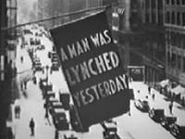




Slide 35
“If We Must Die”
If we must die, let it not be like hogs
Hunted and penned in an inglorious spot,
While round us bark the mad and hungry dogs,
Making their mock at our accursed lot.
If we must die, O let us nobly die
So that our precious blood may not be shed
In vain; then even the monsters we defy
Shall be constrained to honor us though dead!
O kinsmen! We must meet the common foe!
Though far outnumbered let us show us brave,
And for their thousand blows deal one death blow!
What though before us lies the open grave?
Like men we’ll face the murderous, cowardly pack,
Pressed to the wall, dying, but fighting back!
Claude McKay, “If We Must Die,” in Harlem Shadows: The Poems of Claude McKay (New York: Harcourt, Brace and Co., 1922).

Slide 36









The outcomes of the debate
African Liberation:
1957 Ghana independence,
1960 UN declares Africa Year,
1963 Organization of African Unity
Civil Rights:
1941 FEPC
End of “White Primary”
Brown v Board
Cultural Explosion
1900’s Great Migrations
1920’s Harlem Renaissance
1940’s Chicago Renaissance
Political leadership
1928 Oscar De Priest
1943 William Dawson
1945 Adam Clayton Powell
Kwame Nkrumah, Jomo Kenyatta, Haile Selassie
Franklin D. & Eleanor Roosevelt, Charles Houston, Thurgood Marshall
Alain Locke, Aaron Douglas, Langston Hughes

Slide 37






Black Liberation Debate
The debate made a revolutionary leap to changing all of society!

Slide 38


Context for the third Great Debate
Demography: Great Migration
leads to the post WWII generation
as first urban born majority
Political context: 1954 Supreme
Court decision unleashes upsurge
in the desire for freedom
Movement: Militant youth lead
the way from CORE to SNCC
Africa: African liberation takes
up armed struggle
Culture: Black Arts Movement
begins to change minds and lifestyle

Slide 39
Black Liberation Movement changes the debate
Emigration: Focus was now on consciousness
and a renewal of Africa at the center of Black
identity. Big change of national identity from
Black to African American.
Negotiation: As the Black middle class moved
inside the system, a major class split ruptured
Black unity.
Fight: A renewal of power at the center of
the struggle, with continued flare ups of armed
resistance

Slide 40




Black women continued to lead!
Fannie Lou Hamer
1917 - 1977
Dorothy Height
1912 - 2010
Ella Baker
1903 - 1986
Shirley Chisholm
1924 - 2005
A people's revolution that engages the participation of every member of the community, including men, and women, brings about a certain transformation in the participants as a result of this participation. Once you have caught a glimpse of freedom or tasted a bit of self-determination, you can't go back to old routines that were established under a racist, capitalist regime. We must begin to understand that a revolution entails not only the willingness to lay our lives on the firing line and get killed. In some ways, this is an easy commitment to make. To die for the revolution is a one shot deal; to live for the revolution means taking on the more difficult commitment of changing our day-to-day life patterns.
—Fran Beale 1969, from a Black Women’s Manifesto

Slide 41



The dispossessed of this nation – the poor,
both white and negro – live in a cruelly unjust
society. They must organize a revolution
against that injustice, not against the lives
of the persons who are their fellow citizens,
but against the structures through which the
society is refusing to take means which have
been called for and which are at hand, to life
the load of poverty.
The decade of 1955 to 1965 with its
constructive elements misled us. Everyone
underestimated the amount of violence and
rage Negroes were suppressing and the amount
of bigotry the white majority was disguising.
From Trumpet of Conscience
Martin Luther King
1929 - 1968
Mass Protest
Moral Transformation

Slide 42




"I am not a racist.... In the past I permitted myself to be used...to make sweeping indictments of all white people, the entire white race and these generalizations have caused injuries to some whites who perhaps did not deserve to be hurt. Because of the spiritual enlightenment which I was blessed to receive as a result of my recent pilgrimage to the Holy city of Mecca, I no longer subscribe to sweeping indictments of any one race. I am now striving to live the life of a true...Muslim. I must repeat that I am not a racist nor do I subscribe to the tenants of racism. I can state in all sincerity that I wish nothing but freedom, justice and equality, life, liberty and the pursuit of happiness for all people."
Malcolm X
1925 - 1965
Revolutionary
Ideology

Slide 43















From outside (1960’s) to the inside (2000’s)
Civil rights
activists
who went
into
electoral
politics
on the
basis of
negotiating
for
freedom
within
the system
John Lewis
Jesse Jackson
Andrew Young
Dorothy Tillman

Slide 44



The debate continued:
Congress of African People (1970), Black Political
Assembly (1972), Million Man March (1995)

Slide 45



Black Studies hosted many critical debates
The debate got so heavy that
a national conference was
hijacked and the opening plenary
lasted all day. The players were
Haki Mahubuti, Kwame Ture, and
Abdul Alkalimat. All sessions at a
national meeting were cancelled
and the participants carried on
the Marxist-Nationalist debate
for 8 hours! Workers from the
auto plants joined the scholars;
that intensified the debate.

Slide 46

African Liberation sparked an intense Marxist-Nationalist Debate
ALSC Executive Committee: Owusu Saudaki, John Warfield, Brenda Paris, Gene Locke, Akinlabi, Amiri Baraka, Abdul Alkalimat
This debate worked the axis of class versus national liberation, or what has been
misnamed as class versus race. It changed the emigrationist posture to one of global unity to aid African armed struggle for liberation. It also connected with the global split in socialism between China and the USSR.

Slide 47






The Black Radical Congress continued the debate (1998)
Bill Sales
Sam Anderson
Manning Marable
Jarvis Tyner
A New York Polarity

Slide 48




King was attacked, sparking a debate
King has been
attacked on
many fronts but
he remains a
national icon.
He survives
attempts to
“humanize” him
and deny Black
people a
great symbol
of hope.

Slide 49



Malcolm X was attacked, sparking a debate
As usual the attack was sexual, personality
based, and politically against his
revolutionary ideology based on a
convergence of the radical Black ideological
frameworks in the tradition of the African
American improvisational political culture.

Slide 50

Outcomes: Change does not = liberation
We elected politicians to run cities, states, and even a president.
But we are still not first class citizens.
After the end of colonialism, Africa continues to suffer from
neo-colonialism.
Black Studies has delinked from the Black liberation movement and
is dominated by public intellectuals who have betrayed the legacy.
Black people have a declining quality of life – shorter life spans,
drugs, all kinds of health crises, lower educational attainment,
and continued police abuse.

Slide 51
Obama: What debate is needed?
2008 arguments for Obama | What has happened?
A Black President would be good for Black people, good for Africa | Blacks continue to suffer from all the usual problems and police abuse. Obama invaded Libya and Killed its President, and now has US troops in Uganda!
The economy would improve, so people would get jobs and go back to work | He brought bankers into the White House, ignored the trade union movement in appointments, and unemployment rose!
Obama is a community organizer, and therefore would always side with the people over the corporate elites | What issue has he stood by us on – Health? Ending war? Student loans? Making those responsible serve time in jail?
Back to Martin King and Malcolm X: Can Black liberation be achieved
within capitalism? Is a revolution needed for Black liberation? King
said he couldn’t wait. Charlie Parker said “Now is the time.”

Slide 52









The Anthology as genre to study debate
Henry Louis Gates &
Nellie McKay, eds
Manning Marable &
Leith Mullings, eds
Molefi Kete Asante &
Abu Abarry, eds
Each of these volumes contains fundamental material, but the weakness is their focus on diversity and not debate. There is little focus on the key conferences and the main threads of inter-textuality. This work remains to be done. Together, they debate!

Slide 53





Black Studies is the institutional home of the debates
but too often dogma or polite discourse eliminates
debate. Critical questions for each campus to ask:
Have the Great Debates been studied on campus?
Have we trained our students to debate?
Do we always feature opposing views in debate?
Does our campus have a class bias?
Do we invite the community into our forums?
Do we encourage disagreements & free thinking?

Slide 54

So, why this lecture series?
Black Studies got caught in the post-modern malaise of believing there is no master narrative, so we had to revisit the basics.
We have to prepare for the coming storm and get people ready for the next Great Debate.
Take legitimacy from the elites in the academic mainstream and affirm Black autonomous agency.
As Fanon has instructed, each generation has a mission.
It’s time to find ours once again.

Slide 55
What have we learned about debates?
Debates are fundamental for freedom consciousness.
Modes of social disruption produce Great Debates
Debates enlighten and polarize.
Debates transform dogmatists when linked to practice.
Inter-textuality is the key to unity, convergence.
Debates are not won by votes.
Debates are about the people not public intellectuals.
Principles endure which ad hominem destroys.
Great Debates never end, but are revisited often.
Debates must be documented and archived.
Debates must be the foundation of education.
Debates must be inclusive of gender and generation.
What is the next Great Debate?

Slide 56

Thank you for watching. Please send comments to
H-Afro-Am@H-Net.msu.edu

